Slide 1

Crime Record Management System
CSA0515- DATABASE MANAGEMENT SYSTEM FOR ADVANCED ANALYTICS
Presented by: Guided by:
J. Lakshmi devi (192524300) Dr. M. Shakila
S. Sadhana(192524298) Dr. Rashmita Khilar
Devadharshini E (192524483 )

Slide 2
INTRODUCTION
Crime Record Management System is a computerized system used to manage crime-related data.
It stores details of crimes, criminals, victims, and investigations in a central database.
Reduces manual paperwork and human errors.
Enables quick searching and retrieval of records.
Improves data security and confidentiality.
Helps police in effective crime analysis and decision-making.

Slide 3
PROBLEM STATEMENT
Traditional crime record maintenance is mostly manual and paper-based.
Manual systems are time-consuming and prone to errors and data loss.
Searching and retrieving old crime records is difficult and slow.
Lack of centralized data leads to poor coordination between departments.
Data security and confidentiality are not well maintained.
Inefficient record management affects timely investigation and decision-making.

Slide 4
OBJECTIVES
To develop a centralized system for managing crime records.
To reduce manual work and improve efficiency.
To provide quick and easy access to crime-related information.
To ensure secure storage of sensitive data.
To support effective crime analysis and investigation.
To improve coordination among law enforcement departments.

Slide 5
PROPOSED SYSTEM
A web-based computerized system to manage crime records efficiently.
Centralized database for storing crime, criminal, victim, and case details.
Authorized users can add, update, view, and delete records securely.
Fast search and retrieval of crime information.
Role-based access to ensure data security and privacy.
Generates reports to support investigation and decision-making.

Slide 6
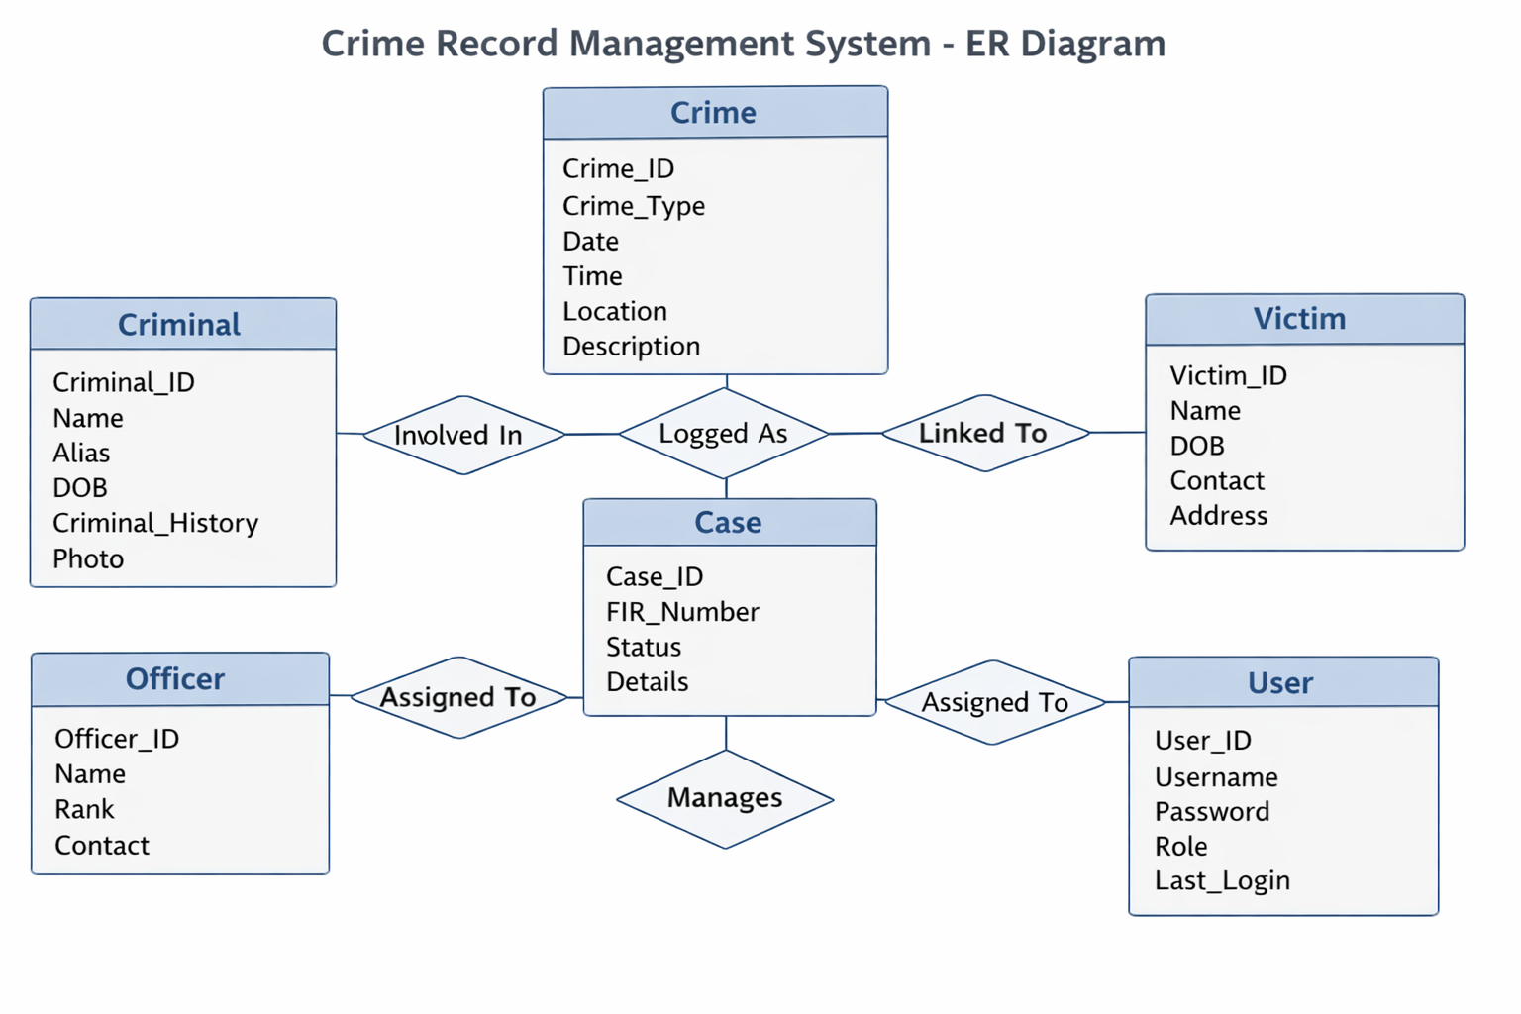
ER DIAGRAM

Slide 7
Module 1: Crime & Case Management
Register and manage crime details systematically.
Record crime type, date, time, location, and description.
Generate and track FIR and case numbers.
Assign cases to investigating officers.
Update case status during different stages of investigation.
Maintain complete case history for reference and legal purposes.

Slide 8
Module 2: Criminal & Victim Records Management
Store and manage criminal personal information.
Maintain criminal history and repeat offense records.
Record victim details related to each crime.
Link criminals and victims with respective crime cases.
Support identification and verification of individuals.
Provide structured records for investigation and analysis.

Slide 9
Module 3: User Management & Reporting
Manage users such as administrators and police officials.
Control system access based on user roles.
Ensure security and confidentiality of sensitive data.
Generate crime reports and statistical summaries.
Support crime trend analysis and decision-making.
Maintain logs of user activities for accountability.

Slide 10
Results and Discussion
The Crime Record Management System provides centralized storage of crime-related data.
Record management is faster and more accurate than manual systems.
Easy search and retrieval reduce time and effort in investigations.
Data redundancy is minimized through structured database design.
Role-based access improves data security and confidentiality.
Report generation supports effective crime analysis and decision-making.

Slide 11
Conclusion
The Crime Record Management System provides an efficient and organized approach to managing crime records.
It replaces manual record-keeping with a centralized digital system.
The system improves data accuracy, security, and accessibility.
It supports faster investigations and better decision-making.
Overall, the system enhances the effectiveness of law enforcement operations.

Slide 12
Future Enhancements
Integration with biometric systems such as fingerprint and face recognition.
Real-time crime data sharing between different police departments.
Advanced crime analysis using data analytics and AI.
Mobile application support for field officers.
GPS-based crime location tracking and mapping.
Cloud-based storage for better scalability and availability.

Slide 13
References
K. K. Patil, S. R. Patil, “Design and Implementation of Crime Record Management System,” International Journal of Computer Applications, Vol. 120, No. 5, 2015.
A. Sharma, R. Singh, “Web-Based Crime Information Management System Using Database Technologies,” International Journal of Engineering Research and Technology (IJERT), Vol. 6, Issue 4, 2017.
M. A. Ahmed, S. H. Khan, “Crime Data Management and Analysis Using Database Systems,” International Journal of Advanced Research in Computer Science, Vol. 9, No. 2, 2018.

